Slide 1
Seminar, 17.3.22
Covert channel in Monero

Slide 2







Slide 3


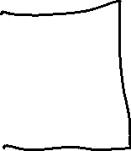


Slide 4




Slide 5
















Slide 6





Slide 7



Slide 8








Slide 9







Slide 10




Slide 11







Slide 12




















Slide 13








Slide 14


































Slide 15





















Slide 16






























Slide 17








































Slide 18























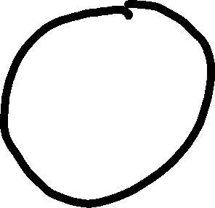









Slide 19












Slide 20


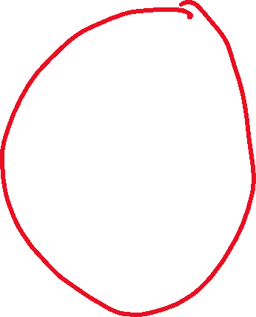

Slide 21











Slide 22




















Slide 23










Slide 24




















Slide 25
















